Slide 1
ADBMS
(Unit 6)

Slide 2
Database- Revisited
A database is an organized collection of data, typically stored and accessed electronically from a computer system.
It is designed to efficiently manage and store large amounts of information, such as customer records, inventory data, financial transactions, and more.
# of users can be 1 or more.
Database architecture when #of users are more than one?

Slide 3
Centralized database
is a type of database architecture where all data is stored in a single location, usually on a central server or mainframe computer.
Advantages:
Easier to ensure data consistency as updates are made at a single location.
Easier data management as it is easy to schedule database backup, database updates, and performance monitoring at a single location.
Scalability: It is easier to add more resources at a single location.
Disadvantages:
Slower performance and lack of availability
Less secure as single point of failure
C1
C2
…
Cn
Database

Slide 4
Decentralized database
is a type of database architecture where data is distributed across multiple nodes or computers in a peer-to-peer network.
each node has a copy of the data and is responsible for processing and storing its own data.
Advantages:
More resilient to failures. If one node fails, the data can still be accessed from other nodes.
Improved scalability as the processing and storage load can be distributed across multiple nodes. It improve performance and reduce the risk of bottlenecks.
Disadvantages:
More complex to manage than centralized databases as data is distributed across multiple nodes.
May be slower than centralized databases where data needs to be accessed from multiple nodes.

Slide 5
Distributed Database
is a type of database architecture where data is spread across multiple nodes or computers in a network, with each node having a portion of the database.
divides data into fragments or partitions, and each fragment is stored on multiple nodes to ensure redundancy and availability. The distribution of data across nodes can be based on a variety of factors, such as geographic location, function, or type of data.

Slide 6
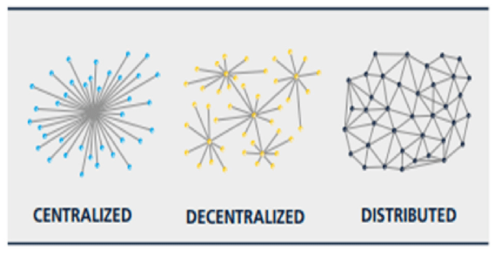
Comparison

Slide 7
Advantages of Distributed Database
Improved data availability as the data is replicated across multiple nodes. If one node fails, the data can still be accessed from other nodes.
Increased scalability as it can be scaled horizontally by adding more nodes to the network. This allows for better performance as the workload is distributed among multiple nodes, instead of being handled by a single central server.
Improved performance as it offers improved availability due to data being located closer to the user. It reduces network latency and improve query response times.
Enhanced data security as it replicates data across multiple nodes, making it more difficult for unauthorized access or data loss.

Slide 8
Types of DDBMS- Homogeneous DDBMS
is a type of distributed database system where all nodes have the same hardware and software configuration, and the same database schema. In other words, all nodes are identical and have the same functionality.
Advantages:
simplifies database administration as all nodes are the same that eases management & maintenance of the database.
provides a higher degree of transparency to users since they can access the same data and use the same query language across all nodes.

Slide 9
Heterogeneous DDBMS
is a type of DDBMS where each node may have different hardware and software configurations, as well as different database schemas. In other words, the nodes are not identical and may have different functionalities.
Advantages:
It allows for more flexibility and scalability than a homogeneous DDBMS as different nodes can be optimized for different workloads, and specialized hardware or software can be utilized to improve performance.
It can handle a wider range of workloads than a homogeneous DDBMS.

Slide 10
Homogeneous vs. Heterogeneous DDBMS
 | Homogeneous | Heterogeneous
Hardware and software configuration | Same in all nodes | May be different in all nodes
Database schema | Same in all nodes | Nodes may have different database schemas
Flexibility and scalability | Less Flexible | More Flexible*
Management and maintenance | Easier to manage | Tougher to manage
Data consistency and transparency | **Easier | Tougher
*nodes can be optimized for different workloads
**users are accessing same data and using same query language across all nodes

Slide 11
Object-Oriented DBMS
is a type of DBMS that stores data in the form of objects, rather than using tables and rows like in traditional relational databases.
In an OODBMS, data is stored as objects that have attributes (data fields) and methods (operations that can be performed on the object).
Objects can be organized into classes, which define the attributes and methods that are common to all objects of that class.
Objects can be related to each other through inheritance and association.

Slide 12
Advantages of OODBMS
Better support for complex data structures: OODBMS can better handle complex data structures, such as graphs and hierarchies, which can be difficult to represent in a traditional relational database.
Improved performance: OODBMS can provide improved performance since it can retrieve related data in a single query, reducing the need for joins and increasing query efficiency.
Easier programming: OODBMS can simplify programming since it allows developers to work with objects and methods, rather than with tables and rows.
Increased flexibility: OODBMS can offer increased flexibility since it can support different types of data and can be easily modified to meet changing business requirements.

Slide 13
Disadvantages of OODBMS
Difficult data migration as it lacks standardization.
Limited adoption as it is not as widely used as traditional relational databases.
Increased complexity as it is complex to design and manage than traditional relational databases, requiring specialized knowledge and skills.
Example of OODBMS: ObjectStore, Versant etc.

Slide 14
Distributed Deadlock

